Slide 1
Vector Search
Even with millions of vectors, vector database search works faster. How?
Vector databases uses a technique called Approxmiate Nearest Neighbour to find the matching vector

Slide 2
ANN is more like KNN. Using KNN is too slow, as it will compare all the 1 million vectors against the query vector
ANN, a KNN based search, approximates and greatly simplifies the distance calculation

Slide 3
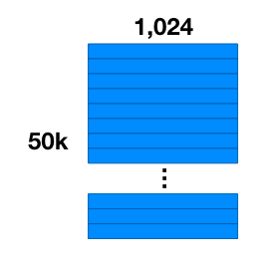
Convert the 50k records into vectors (dimension=1024)

Slide 4
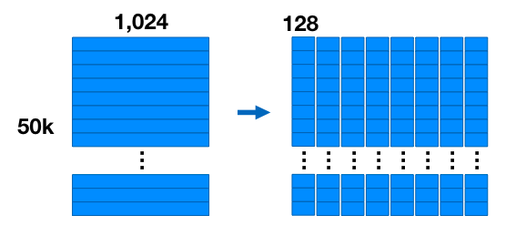
Divide each vector into 8 parts. 1024/8 = 128 sub vectors

Slide 5
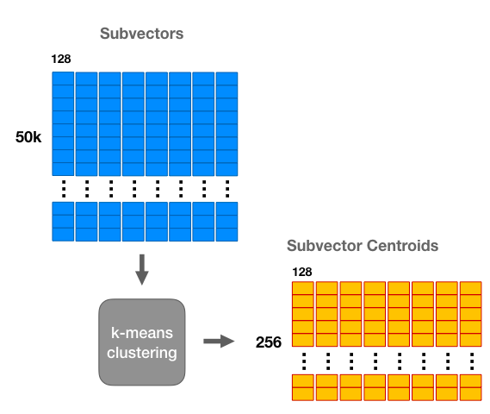
Apply Kmeans clustering algorithm with K=256. Now, we will have 256 centroids and vectors around them

Slide 6
For each vector, find the nearest centroid.
Instead of saving the floating point value, save the centroid id
As we have divided our vector into 8 segments. We will have 8 centroid ids for each of the vector

Slide 7
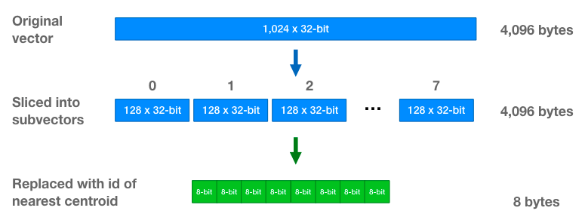
We are now down to 8 bytes (from 4096 bytes)

Slide 8
We cannot do the distance comparison , as we no longer have the floating point values
Divide the query vector into 8 parts.
Find the L2 distance of the 256 centroids with the 8 parts
For each record (50k), we are going to sum up the distance. We already know the centroid id. Just do the lookup and sum up the distance.
This gives the same distance as comparing all the 50k vectors, but in much lower compute cost
Finally, sort the distance and find which one is near

Slide 9
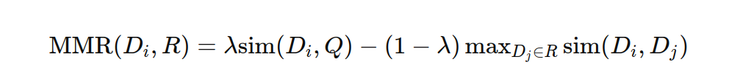
Maximum Marginal Relevance (MMR)

Slide 10
The first term encourages selecting the items which are more relevant to the query (relevancy)
The second term penalizes that are too similar to each other (diversity)

